Slide 1
How to Make Progress & Produce Desired Results in 2022
Coach Tina
Sept 7-9th

Slide 3
How to Make Progress & Produce Desired Results in 2022
3 Day Challenge
Day 1: LEARN

Slide 4
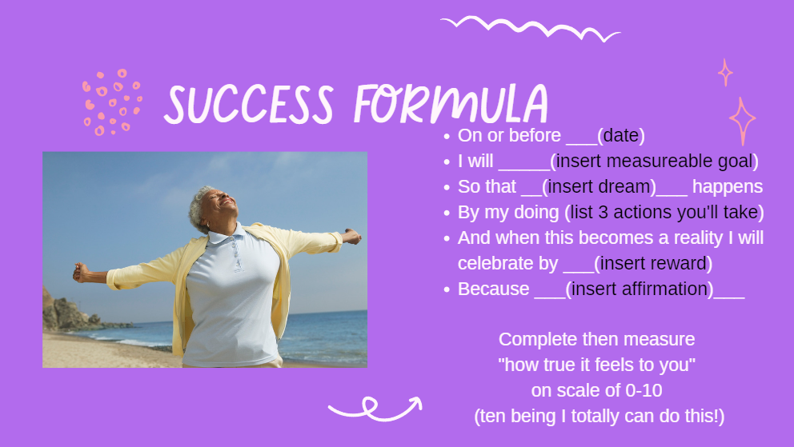
How to Make Progress & Produce Desired Results in 2022
3 Day Challenge
Day 1: HW Assignment
https://www.facebook.com/photo/?fbid=10159095986359016&set=gm.809434063573230&idorvanity=453269065856400

Slide 5
How to Make Progress & Produce Desired Results in 2022
3 Day Challenge
Day 2: GROW

Slide 6
How to Make Progress & Produce Desired Results in 2022
3 Day Challenge
Day 2: Suggested Action: Follow Link to get your FREE PLANT
(Your Plan for Transformation):
https://usemotion.com/meet/tina-p6b1gmf

Slide 7
How to Make Progress & Produce Desired Results in 2022
3 Day Challenge
Day 3: SHARE

Slide 8
How to Make Progress & Produce Desired Results in 2022
3 Day Challenge
Day 3: Suggested Action: Become a Foundational Member of OO Life Academy Today!
Regular Membership Rate
Will be $20 per month.
Discounted Challenge Rate
$7/mo or $22 for the remainder of 2022.
https://tinagering.com/landing/oo-life-academy

Slide 9
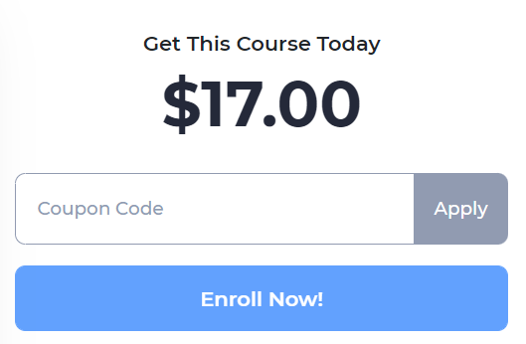
How to Make Progress & Produce Desired Results in 2022
3 Day Challenge
September ONLY Special:
Become a Foundational Member of OO Life Academy this month and get this Mastermind.com Course for only $2.
https://tina-gering-llc.mastermind.com/masterminds/37246

